Slide 1
Arabic-to-English Machine Translation using Pretrained Models
NLP

Slide 2
Problem Statement & Objective
Arabic-to-English translation plays a key role in sharing Arabic content with the global community.
01
02
High-quality translation is essential for making Arabic news and media accessible worldwide.
03
Arabic (Fusha) presents unique linguistic challenges in machine translation.
Project Goal: Fine-tune a pretrained translation model using the Global Voices dataset to produce accurate Arabic-to-English translations.
04

Slide 3
OPUS Global Voices Dataset
Dataset Size
Content Type
63,071 Arabic-to-English sentence pairs
News program-style sentences, structured with Arabic and English translations in parallel
Description
empty or irrelevant words
links or nonsensical values
Challanges
Some sentences contained no text or were corrupted
Certain sentences included links or nonsensical values that needed to be cleaned

Slide 4
Preprocessing Steps
Cleaning & Filtering
Dataset Splitting
Tokenization
Removed empty or too-short sentence
Filtered out noisy data: long numbers, unwanted symbols (e.g., @, {}, <, etc.)
Final cleaned pairs: ~56078
Train: 80%
Validation: 10%
Test: 10%
Applied pretrained tokenizer MarianMT
Max token length 256
Created PyTorch dataset class for efficient batching and training

Slide 5
Model Architecture
Model Used: Helsinki-NLP/opus-mt-ar-en
A pretrained MarianMT model specialized for Arabic-to-English translation
Why this model?
Specifically trained for many language pairs including ar-en
Lightweight and fast, suitable for low-resource settings
Open-source and easy to integrate via Hugging Face Transformers
Fine-Tuning Approach:
Continued training on the cleaned Global Voices dataset
Adjusted for domain-specific vocabulary and structure (news-style content)

Slide 6
Training Details
Batch Size: 32
Learning Rate: 3e-5
Epochs: 3
Checkpoints saved per epoch
Training Configuration:
Google Colab with GPU
Seq2SeqTrainer
Training Loss: 0.275
Validation Loss: 0.233
Time: ~1 hour
Observed Results:

Slide 7
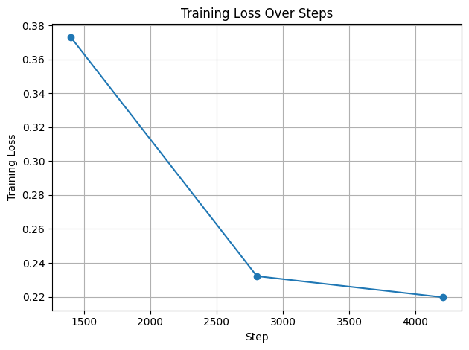


Evaluation And Analysis
Vlidation evaluation
Test Evaluation
Training Evaluation
The training loss steadily decreased over time, indicating that the model was learning effectively during training but later he learn so slowly.
The model achieved a BLEU score of 40.42 and a METEOR score of 0.70 on the first 10 test sentences, indicating high-quality translations that closely match the references in both structure and meaning.
The model achieved a low eval loss of 0.233 in under 40 seconds, showing good performance and fast inference.

Slide 8
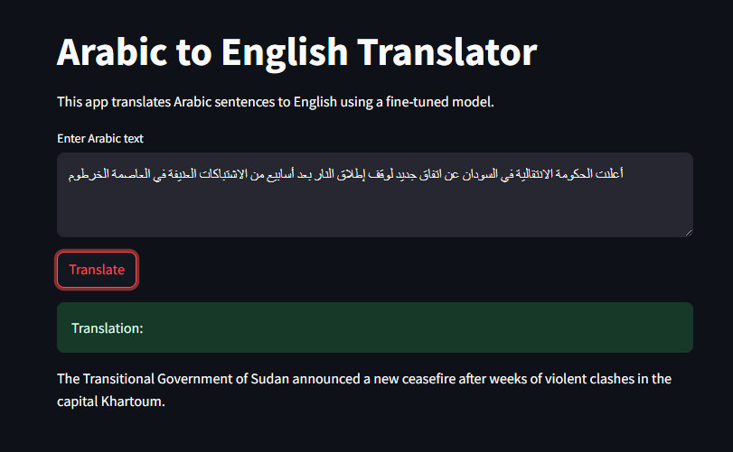
GUI and Example

Slide 9


Thanks!
Team Members
Bassam Emad Hamdy
Buthaina Esam Mohamed
Terevena Reda Amin
Aya Mohamed Ali
Eman Ehab Ebrahiem
Gamil Mohamed Gamil
Bassem yasser Ragab
Do you have any questions?

